Slide 1
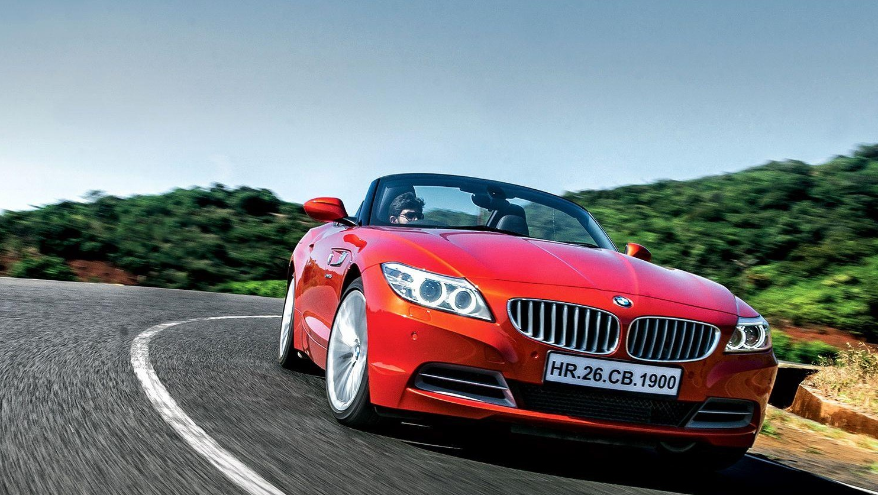
Vehicle Identification System

Slide 2
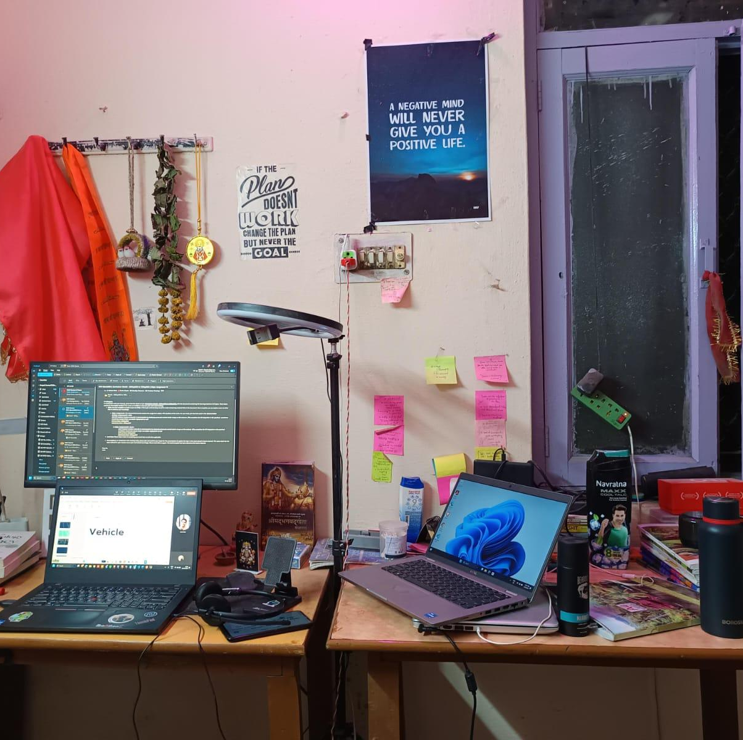

About Me
DevOps Specialist: Streamlining development processes and enhancing efficiency through DevOps.
Full-Stack Coder: Creating end-to-end solutions with expertise in both front-end and back-end development.
Passionate Coder: Thriving on problem-solving challenges and creative opportunities.
1.5+ Years at Nagarro: Contributing to growth and innovation personally and professionally.

Slide 3
Vehicle Identification System
01
Introduction
Brief overview of what a Vehicle Identification System is , Purpose and Importance
02
Tech Stack
Computer Vision ,YOLO v4(You Only Look Once) , OCR(Optical Character Recognition) , Docker, PostgreSQL , Angular and Flask.
03
Demo

Slide 4
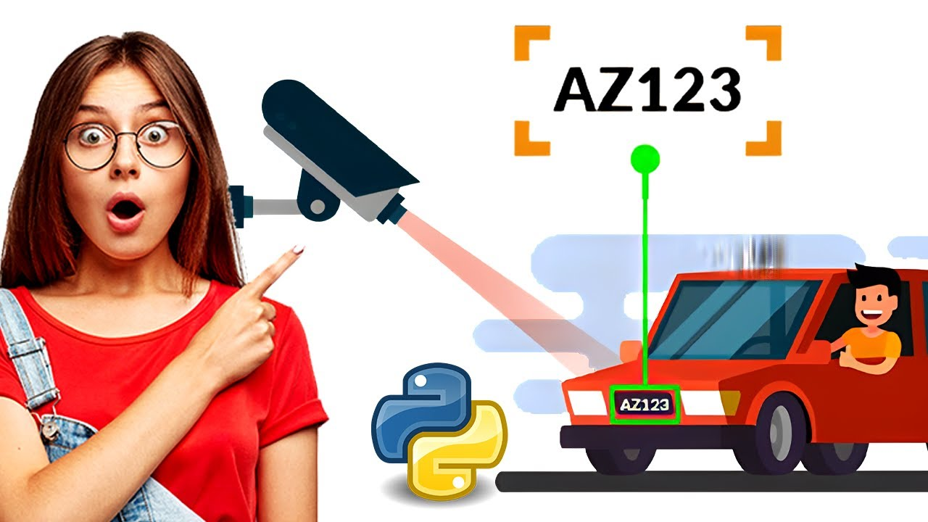
Introduction
In today's tech-driven world, there's a big need for quickly and accurately identifying vehicles. Think about all the traffic cameras, parking systems, and security setups out there. But many current methods aren't up to scratch, causing problems and making things less smooth. Our solution steps in to shake things up. We're offering a super advanced way to identify vehicles that's way better at getting things right quickly and precisely, making everything work smoother and more accurately.

Slide 5
Purpose and Importance
Purpose
Make Things Easier: We're here to make tasks like watching traffic, managing parking, and keeping places safe simpler. We'll do this by letting technology handle identifying vehicles, so everything runs smoothly without needing too much human effort.
Enhance Efficiency: Our aim is to use fancy new tech to do things more quickly and accurately. This means fewer mistakes and less need for people to step in, making everything run smoother and faster.
Improve Security: We want to help keep places secure. By quickly and accurately spotting vehicles, we can help the police and keep an eye on what's happening. This means we can respond faster to any safety concerns and stay on top of what's going on.
Importance
Ensure Safety: Swift and precise vehicle identification is crucial for ensuring road safety, optimizing parking management, and enhancing security surveillance, ultimately contributing to safer communities.
Optimize Resource Utilization: By automating the identification process, organizations can optimize resource utilization, reduce operational costs, and allocate manpower more effectively.

Slide 6
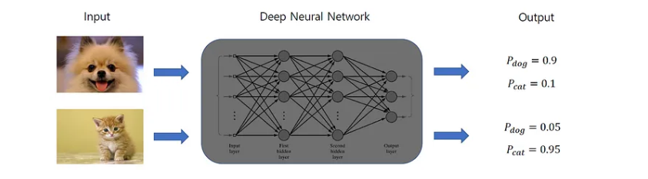
Computer Vision
Computer Vision is a field of artificial intelligence that enables computers and systems to derive meaningful information from digital images, videos, and other visual inputs — and take actions or make recommendations based on that information.
Computer Vision (CV) algorithms work by teaching computers to “see” and understand images and videos like humans do. Here’s a simple breakdown of how it works:
Capture: First, the CV system captures an image or video using cameras.
Preprocess: Then, it might adjust the image to make it easier to work with, like fixing the lighting or turning it into black and white.
Analyze: Next, the CV algorithm looks for patterns in the image—like shapes, colors, or textures.
Understand: Finally, it uses what it’s learned to identify objects or features, like a car’s number plate.
In the context of Automatic Number Plate Recognition (ANPR) systems, CV is used to first find the car within the image, then zoom in on the number plate, and finally read and understand the numbers and letters printed on it. This process helps in quickly identifying vehicles without human intervention.

Slide 7
Computer Vision
How Computer Vision can make a vehicle number plate recognition system more efficient :
Accuracy: Computer Vision algorithms can identify and read number plates with high accuracy, even under varying lighting conditions and angles.
Speed: These systems can process multiple number plates quickly, making them much faster than manual entry or inspection.
Automation: It reduces the need for human intervention, allowing for continuous, automated monitoring without fatigue or errors associated with manual checking.
Integration: Computer Vision systems can be integrated with databases and other applications, enabling real-time vehicle tracking and identification.
Adaptability: They can be trained to recognize different number plate formats from various countries, making them versatile for international use.
Scalability: Once set up, the system can easily be scaled to cover more areas or process more data as needed.
Data Analytics: The data captured can be used for analytics, providing insights into traffic patterns, peak hours, and frequent violations.
Video Frame Capture: The first step is to capture individual frames from the real-time video feed. This is done using computer vision techniques that allow the system to process video as a series of still images.
Preprocessing: Each frame is preprocessed to improve the quality and consistency of the image. This may include resizing, normalization, and conversion to grayscale or other color spaces to reduce computational complexity and improve detection accuracy.

Slide 8
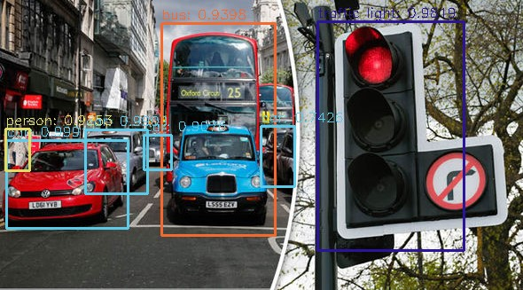
YOLO v4 : You Only Look Once version 4
YOLO v4 is a one-stage object detection model, meaning it does not have a separate region proposal stage like two-stage detectors. It predicts classes and bounding boxes for the entire image in a single run, which makes it efficient and fast, suitable for real-time object detection applications
It was developed to address the need for fast and accurate object detection in images and videos.
Did you know that the YOLO v4 algorithm can process images at a speed of 65 frames per second? That’s faster than the blink of an eye!
YOLO, or ‘You Only Look Once’, is a state-of-the-art, real-time object detection system. It’s designed to be fast, accurate, and reliable for tasks like vehicle identification.
In the world of self-driving cars and managing traffic, it's super important to spot vehicles fast and get it right. YOLOv4 does just that.

Slide 9
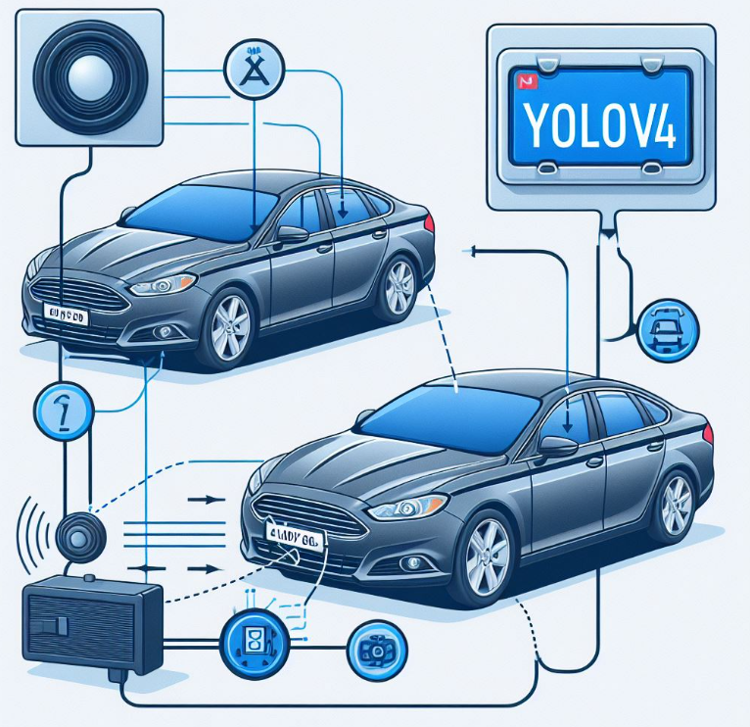

YOLO v4 : Model
YOLOv4 uses a special kind of brain called a neural network to find and categorize things in pictures or videos.
It breaks down the picture into smaller pieces and guesses where things are and how likely they are to be what it's looking for.
It's built with a smart architecture called a deep convolutional neural network (CNN), which helps it work faster and better. It uses tricks like skip connections and spatial pyramid pooling to get things right.
To figure out how big and where things are, YOLOv4 uses something called anchor boxes. This helps it find things accurately.

Slide 10
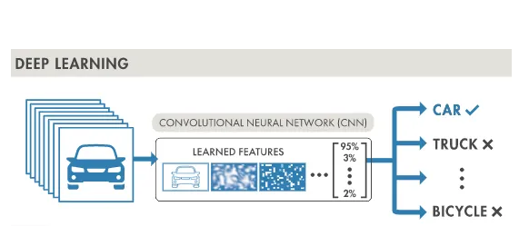
YOLO v4 : How it works
Image Processing: YOLOv4 preprocesses images by resizing and normalizing them to ensure consistency for object detection.
Regression: It uses regression to predict precise bounding box coordinates for object localization within images.
Deep Learning: YOLOv4 leverages deep learning to analyze and learn from image data, enabling accurate object classification.
CNN: The Convolutional Neural Network in YOLOv4 efficiently extracts features from images, crucial for detecting objects in real-time.

Slide 11
OCR
OCR stands for Optical Character Recognition. It’s like teaching a computer to read the letters and numbers on things like a vehicle number plate.
OCR can be integrated with a wide range of programming languages, including Python , C, C++, C# & Java each offering libraries and frameworks to facilitate text recognition
Here’s how it works:
Image Capture: ANPR systems first capture an image of a vehicle’s number plate using cameras.
Preprocessing: The image undergoes preprocessing to enhance the quality and readability of the number plate.
Plate Localization: The system then locates the number plate within the image.
Character Segmentation: Once the number plate is isolated, the system segments the characters on the plate.
OCR: This is where OCR comes into play. The segmented characters are analyzed by the OCR algorithm, which converts the images of characters into machine-encoded text.
Post-processing: The recognized text may undergo post-processing to validate or format it according to specific requirement

Slide 12
OCR
How OCR makes recognizing number plates more efficient:
Quick Reading: OCR can look at a number plate and quickly tell you what the letters and numbers are.
Always Accurate: It doesn’t make mistakes that a person might make when reading lots of number plates.
Works Anytime: OCR can read number plates day or night, so it’s always working.
Saves Time: It’s much faster than typing out the number plate info by hand.
Smart Matching: OCR can match the number plate info with records in a database to find out more about the vehicle. Multilingual Mastery: OCR isn’t limited by language; it can read number plates in multiple languages, making it versatile for global use.
Adapts to Changes: As number plate designs change over time, OCR can adapt to recognize new formats with minimal updates.
Reduces Congestion: By speeding up vehicle checks, OCR contributes to reducing traffic congestion, especially in toll booths and checkpoints.
Environmentally Friendly: Faster processing leads to less idling time for vehicles, contributing to lower emissions and a cleaner environment.

Slide 13
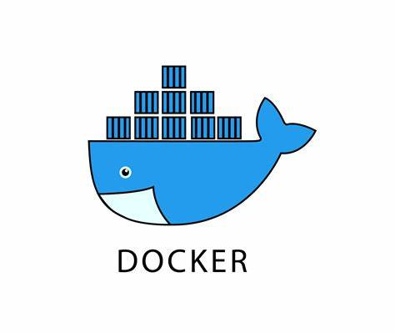
Docker
Docker is a platform for developing, shipping, and running applications.
It utilizes containerization to package software and its dependencies into standardized units called containers.
Key Features of Docker:
Containerization: Allows applications to be isolated in containers,
ensuring consistency across different environments.
Portability: Containers can run on any platform that supports Docker,
providing a consistent environment from development to production.
Efficiency: Docker optimizes resource usage by sharing the host OS
kernel, reducing overhead and improving performance.
Scalability: Easily scale applications by deploying additional containers
as needed.

Slide 14

Efficient Database Management with PostgreSQL Docker Image
Docker and PostgreSQL are pivotal in modern software development and database management. Docker simplifies the deployment process through containerization, while PostgreSQL offers robust data storage capabilities. Together, they provide a seamless environment for developing and managing databases with ease and flexibility.
Utilizing the PostgreSQL Docker image brings numerous benefits:
Ease of Deployment: Launch databases with a single command,
eliminating complex installation procedures.
Isolation: Each container operates independently, reducing conflicts
between databases and applications.
Consistency: Docker containers ensure that PostgreSQL runs the
same way, regardless of the underlying infrastructure.

Slide 15
Advantages
To maximize the PostgreSQL Docker container’s efficiency:
Data Persistence: Use Docker volumes to persist data beyond the container’s lifecycle.
Security: Secure your database by managing user access and utilizing Docker secrets.
Performance: Monitor resource usage to ensure optimal performance and adjust configurations as needed.

Slide 16
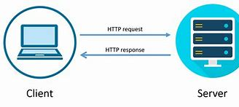
Streamlining HTTP Communication with Flask API
Flask, a Python microframework, excels in crafting lightweight RESTful APIs. Define endpoints (URLs) for functions handling requests (GET, POST) and returning data (often JSON). This flexibility enables building APIs for CRUD (Create, Read, Update, Delete) operations, ideal for mobile/web apps and interacting with other APIs.
Advantages :
Flexibility: Flask API allows developers to design APIs tailored to their specific needs, without imposing strict conventions.
Simplicity: With its minimalist design, Flask API makes it easy to create and maintain web APIs with minimal boilerplate code.
Extensibility: Flask's modular architecture enables the integration of additional functionality through extensions, enhancing API capabilities.
Lightweight: Being a micro-framework, Flask API has minimal overhead, resulting in faster response times and improved performance.
Scalability: Flask API can scale from small, simple applications to large, complex systems, thanks to its modular design and flexibility.

Slide 17
Angular: A Comprehensive Framework for Web Applications
Angular is an open-source framework developed by Google for building web applications
It's a frontend framework that enables developers to create dynamic and interactive user interfaces
Angular’s architecture follows the Model-View-Controller (MVC) and Model-View-ViewModel (MVVM) patterns
It’s used for building dynamic single-page applications (SPAs)
Key Features of Angular:
TypeScript-Based: Ensures improved tooling and maintainability for a better developer experience
Modules: Organizational units that encapsulate components, directives, pipes, and services.
Routing: Manages navigation between views and handling data retrieval.
Services and Dependency Injection: Promotes reusable code and provides dependencies to components.
Directives: Extend HTML with new attributes and behaviors.
Data Binding: Synchronizes data between the model and view components.
Forms Management: Handles form operations and validation.
HTTP Client: Facilitates communication with remote servers

Slide 18
“Let’s jump into Demo Part”

Slide 19
Time for Q&A

Slide 20
Thank You

